Slide 1






MINOR PROJECT
DeepC CAR
An ease to life…

Slide 2
Supervisor: Mr. Ankur Bhardwaj
Presented by: Shubham kumar Tiwari (16102021)
Aman Sharma(16102243)

Slide 3
INTRODUCTION
Self driving cars have been a dream
The automobile is part and parcel in developed world and is becoming so in the developing world
In 2007, the world’s two largest automakers sold over 18 million vehicles worldwide.
As we consider domains to apply intelligent systems, the automotive industry is most potential for impact.

Slide 4
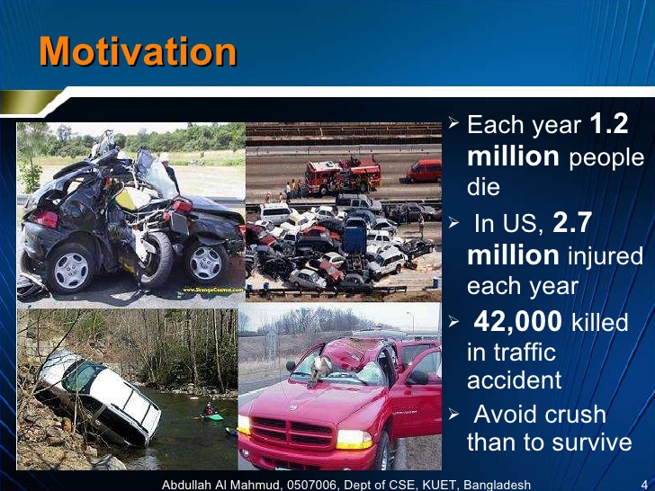
MOTIVATION
a

Slide 5
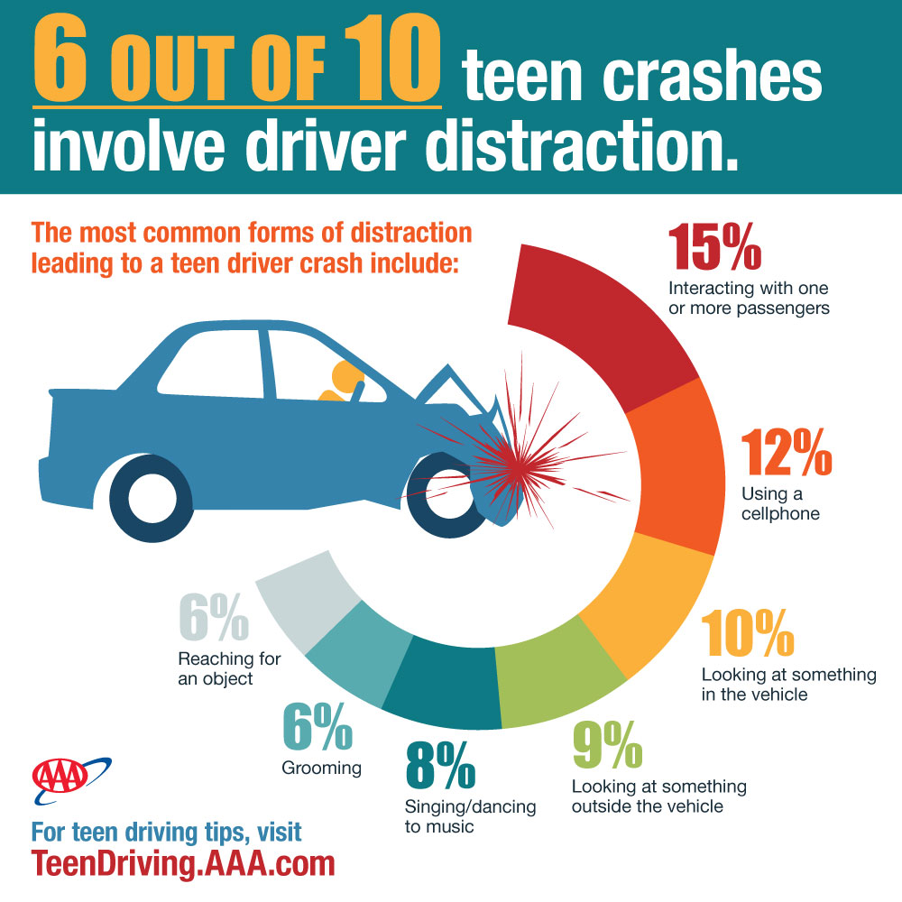
Teen Crash Causes

Slide 6
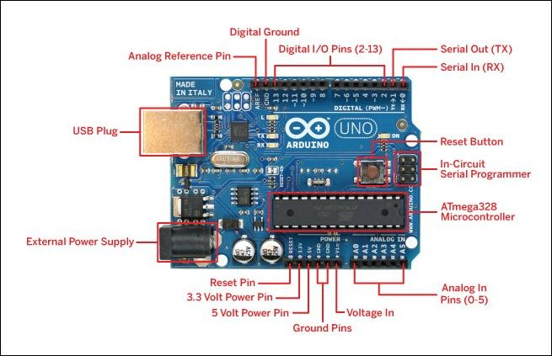
Components used
Arduino Uno:
The Arduino Uno[1] is a microcontroller board based on the ATmega328P.
It has 14 digital input/output pins (of which 6 can be used as PWM outputs).
Has 16 MHz ceramic resonator, a USB connection, a power
jack, an ICSP header, and a reset button.
Hmmm..

Slide 7
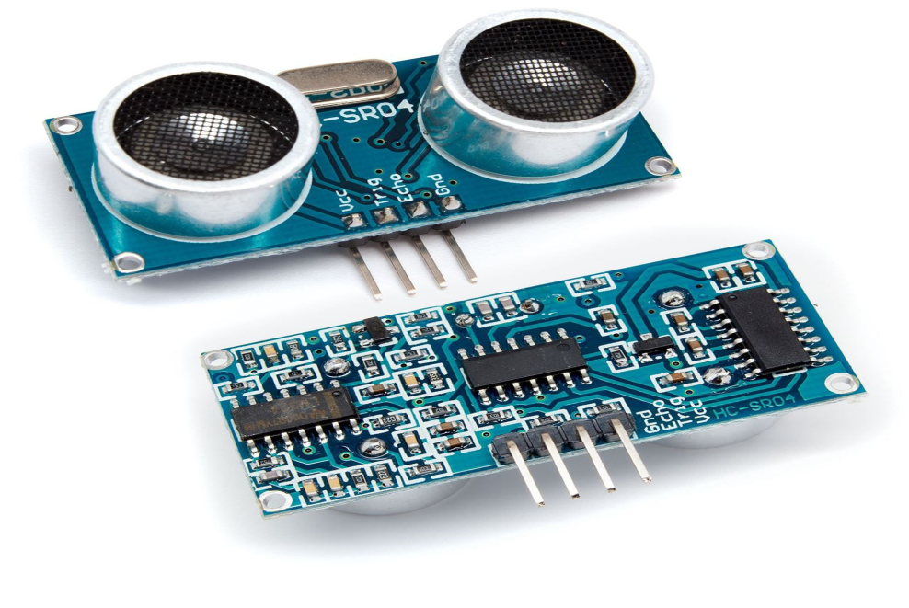
Components used
Ultrasonic Sensors(SR-04):
It measures distance by using ultrasonic waves.
The transmitter head emits an ultrasonic wave and receiver receives the wave reflected back from the target.
Ultrasonic Sensors measure the distance to the target by measuring the time between the emission and reception.
Hmmm..

Slide 8
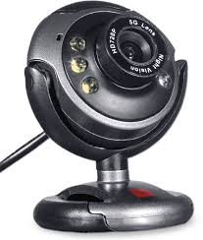
Components used
USB Webcam:
It is a video camera that feeds or streams its image in real time to or through a computer to a computer network.
When "captured" by the computer, the video stream may be saved, viewed or sent on to other networks travelling through systems such as the internet.
When sent to a remote location, the video stream may be saved, viewed or on sent there.

Slide 9
Description
Deep Neural network (DNNs) based car[2] that is able to control its acceleration and steering angle according to the path and also able to detect various obstacles that come its way.
The car will be able to carryout certain actions in order to prevent collisions with the objects.
Camera captures images and provides it to the Convolutional Neural Network (CNNs) that processes the frame (image) in real time.
The obstacle detecting sensors (ultrasonic) prevent the car from hitting the obstacles by providing timely feedback to change its direction of movement.

Slide 10
Convolutional Neural Networks
Convolutional neural networks are deep artificial neural networks that are used primarily to classify images (e.g. name what they see).
Cluster them by similarity (photo search), and perform object recognition within scenes. They are algorithms that can identify faces, individuals, street signs, tumours, platypuses and many other aspects of visual data.
The efficacy of convolutional nets ( CNNs) in image recognition is one of the main reasons why the world has woken up to the efficacy of deep learning.
They are powering major advances in computer vision (CV), which has obvious applications for self-driving cars, robotics, drones, security, medical diagnoses, and treatments for the visually impaired.
This project is making use of CNNs to make a model to depict functioning of self-driving cars.

Slide 11
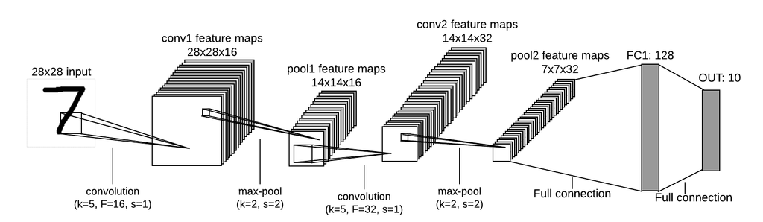
Steps before Feeding Image to CNN

Slide 12
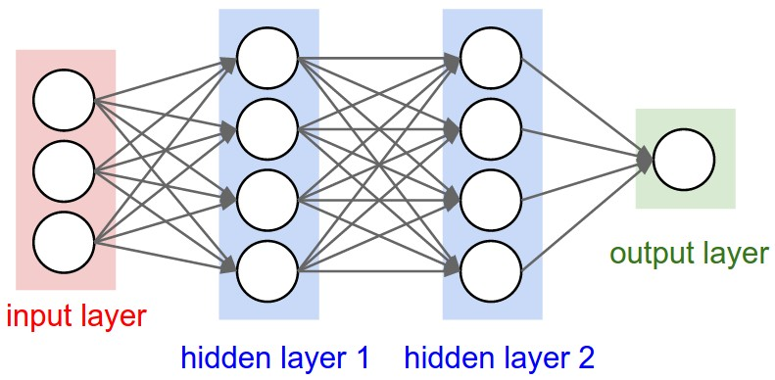
Basic Structure of a CNN

Slide 13
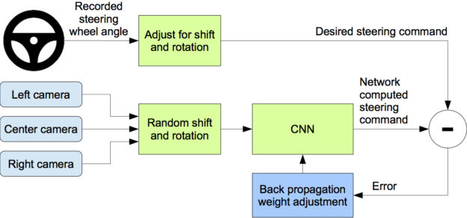
Nvidia Model of Self-driving Cars[
Fig- Procedure Followed to gather dataset & train model for self-driving car model[3]

Slide 14
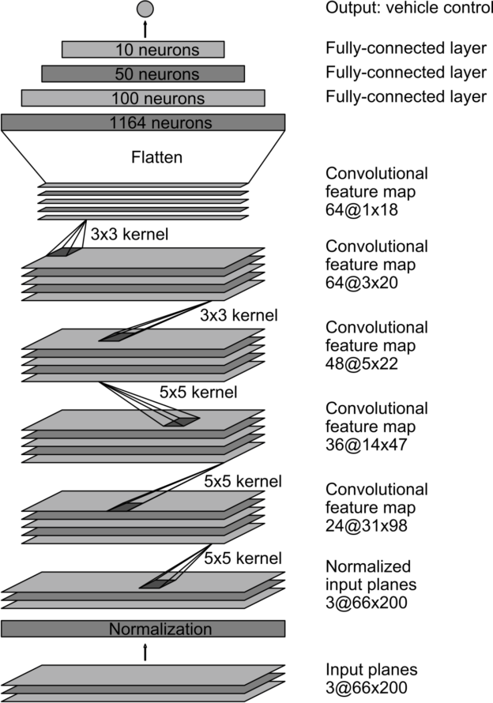
Network Architecture of CNN{4]

Slide 15
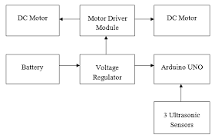
FLOW CHART

Slide 16
Benefits of Autonomous Cars
Safety
Commutating time reduce
A great privilege for the disables
Reduce environmental impact of driving
Autonomous cars & trucks can tune acceleration profiles, reduce wastage of fuels
In mass vehicles, safety and fuel efficiency
THEREBY MAKING THE WORLD A BETTER PLACE!!!

Slide 17
Status of Work
TILL MID EVALUATION:
In Mid-Evaluation Viva ,we had completed the simulation of this project.
We have trained the Convolutional Neural Network (CNN) by feeding the model with images from three cameras and the steering angle and throttle as input data.
The input data was collected by using UDACITY SELF-DRIVING CAR Simulator^{[5]} which consisted of nearly 15,000 images.

Slide 18
Status of Work
IN FINAL EVALUATION:
we have done the Hardware implementation of this project.
The accuracy of the model is around 91% on validation set.
Model follow track with the trained data set from Udacity simulator and Arduino.
Obstacle detection through Haar-cascade which detect stop sign, Vehicle and pedestrian.

Slide 19
Future Advancements
The main aim will be to improve the accuracy and to train the model to handle exceptions.
Also LIDAR can be used instead of ultrasonic sensors as they produce better results in adverse weather conditions.
The project we are aiming to make incorporates “Level 3” autonomy, better training model and some other improvements can help achieve “Level 4” autonomy in the self-driving car model.

Slide 20
Conclusion
This project’s main purpose is to prevent and reduce the damage caused by road accidents by saving their lives.
Make cars available for millions of disabled and elderly people.
Thus many lives can be saved and disabled will be independent.

Slide 21
References
[1] https://i1.wp.com/eeeproject.com/wp-content/uploads/2017/06/Arduino- Uno-board-pins-description.jpg?w=629&ssl=1
[2] Bojarski, M.; Del Testa, D.; et al. End to end learning for self-driving cars. arXiv preprint arXiv:1604.07316, 2016.
[3] https://devblogs.nvidia.com/deep-learning-self-driving-cars/
[4]Chenyi Chen et al. “Deepdriving: Learning affordance for direct perception in autonomous driving”. In: Proceedings of the IEEE International Conference on Computer Vision. 2015, pp. 2722–2730.
[5] Udacity, Inc. Udacity’s Self-Driving Car Simulator. URL: https : //github . com/udacity/self-driving-car-sim (visited on 07/02/2019).

Slide 22

Thank You!!!

